Slide 1
Cultural evolution
Does culture evolve?
How does cultural evolution differ from genetic evolution?
Can we reconstruct cultural phylogenies?
Has culture affected human genetic evolution?

Slide 2
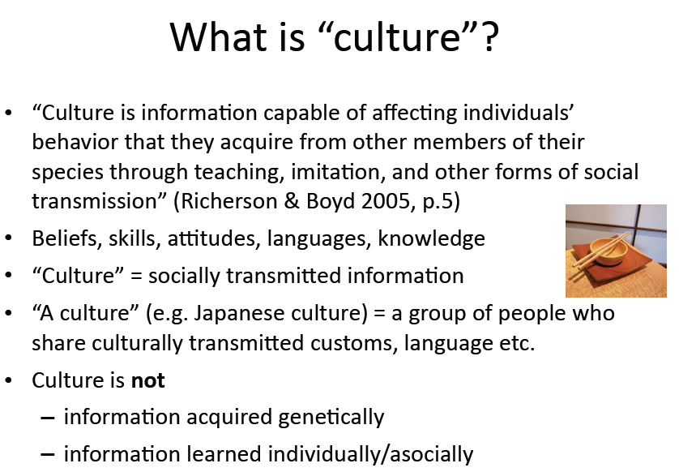

Slide 3
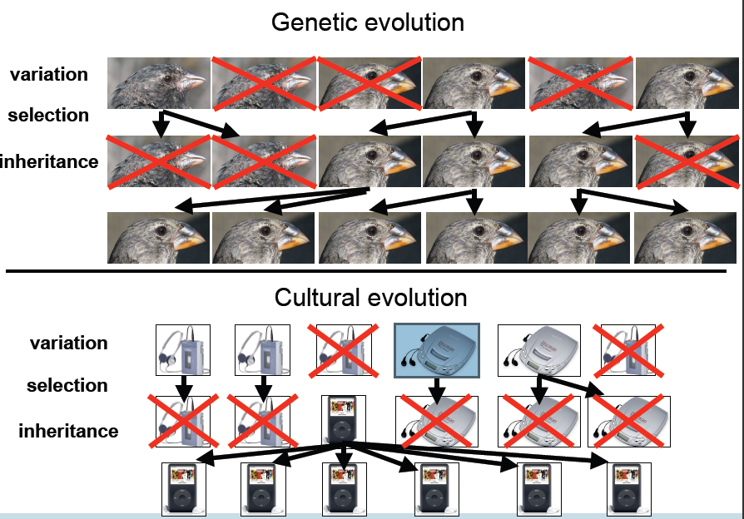

Slide 4
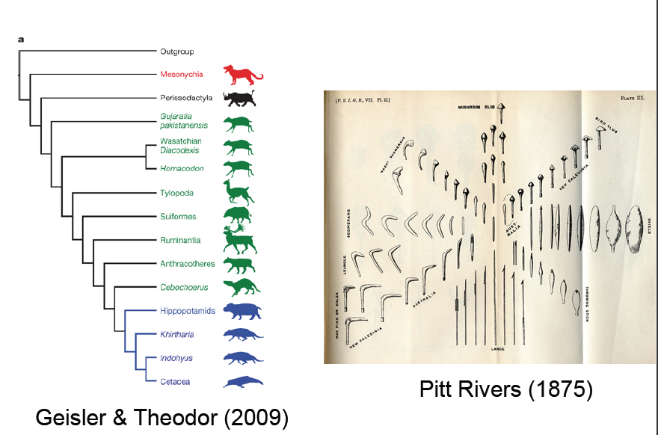

Slide 5
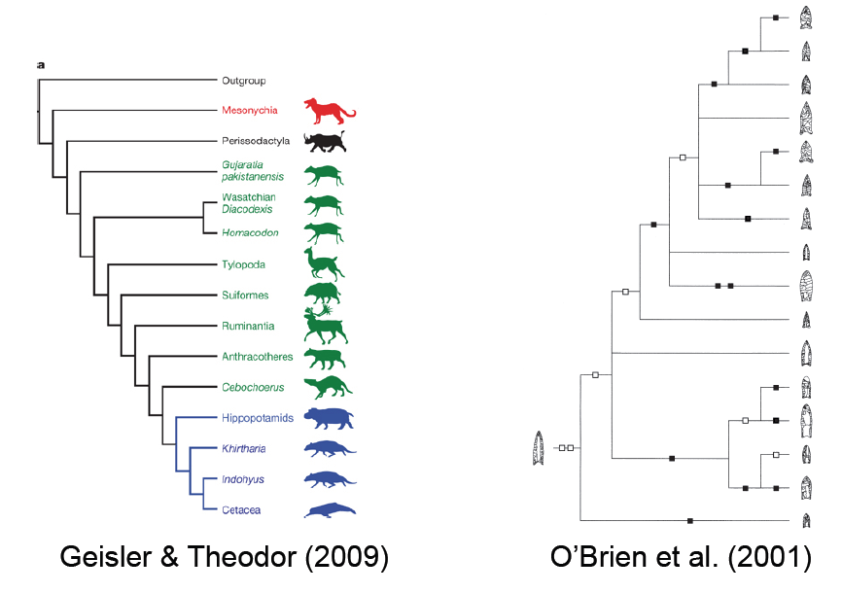

Slide 6
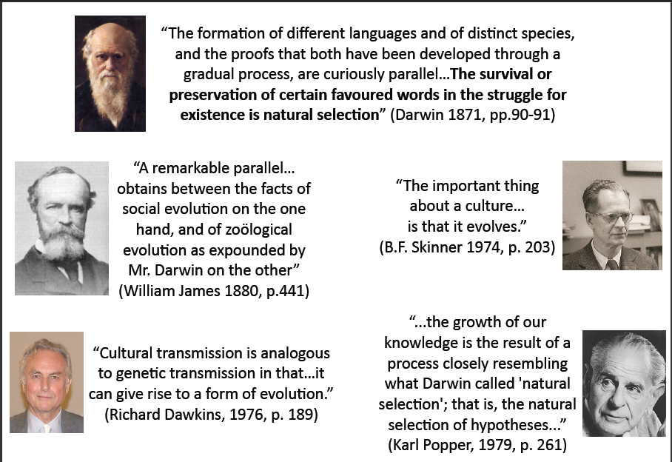

Slide 7
Genes – Memes
Definition: “Examples of memes are tunes, ideas, catch-phrases, clothes fashions, ways of making pots or of building arches. Just as genes propagate themselves in the gene pool by leaping from body to body via sperms or eggs, so memes propagate themselves in the meme pool by leaping from brain to brain via a process which, in the broad sense, can be called imitation.” – R. Dawkins, The Selfish Gene

Slide 8
The spread of memes
“If a scientist hears, or reads about, a good idea, he passes it on to his colleagues and students. He mentions it in his articles and his lectures. If the idea catches on, it can be said to propagate itself, spreading from brain to brain.” –R. Dawkins, The Selfish Gene

Slide 9
Memes as mind parasites?
“When you plant a fertile meme in my mind you literally parasitize my brain, turning it into a vehicle for the meme's propagation in just the way that a virus may parasitize the genetic mechanism of a host cell.” – R. Dawkins, The Selfish Gene

Slide 10
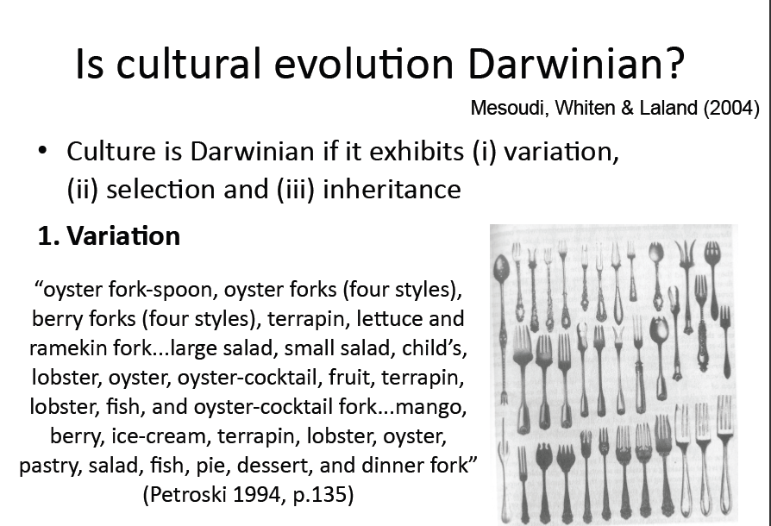

Slide 11
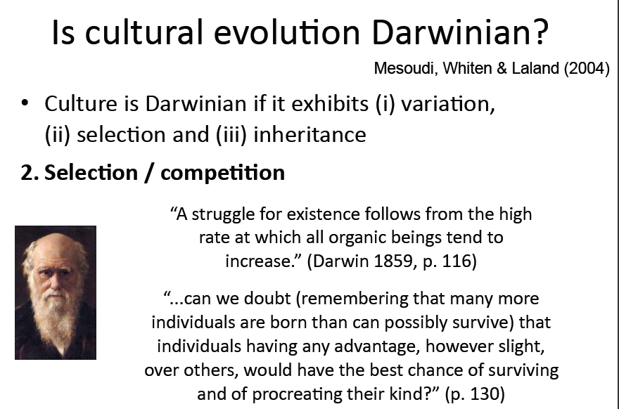

Slide 12
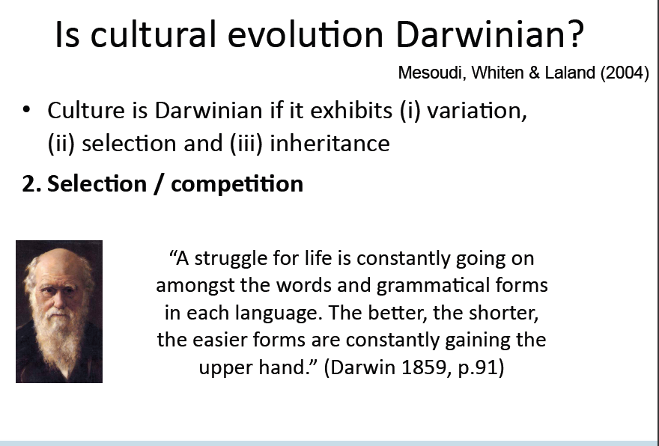

Slide 13
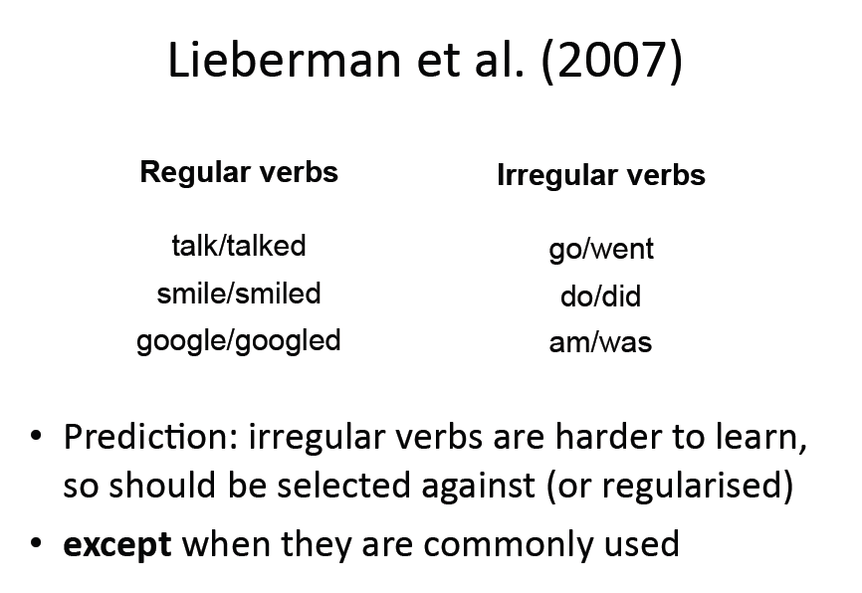

Slide 14
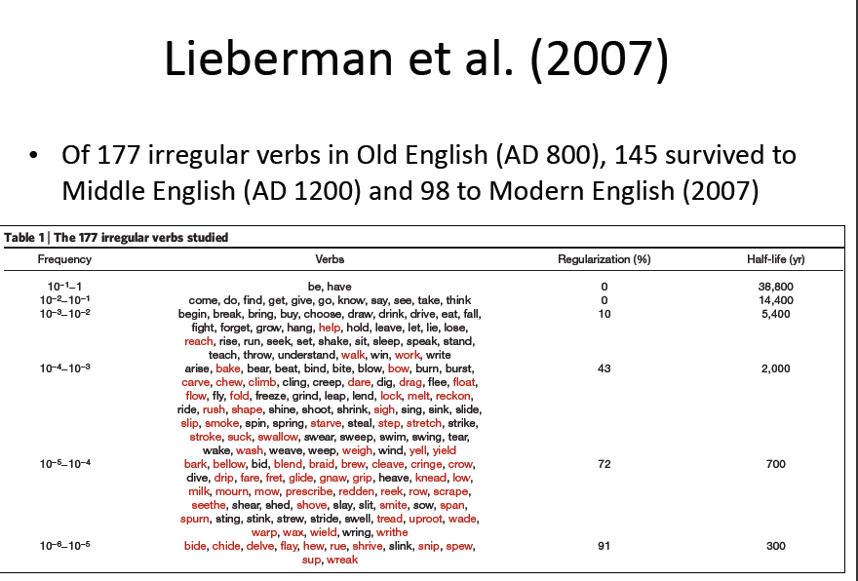

Slide 15
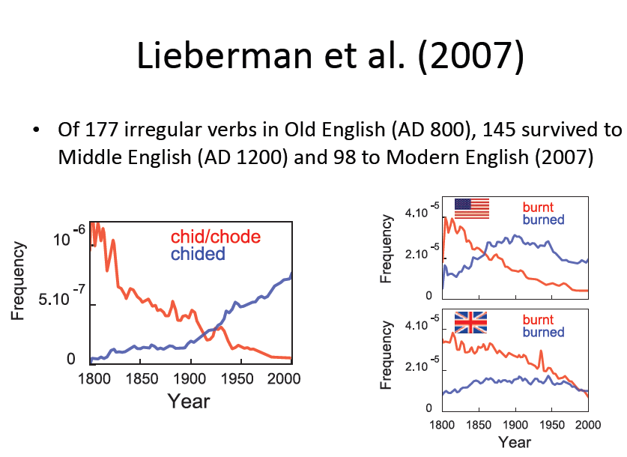

Slide 16
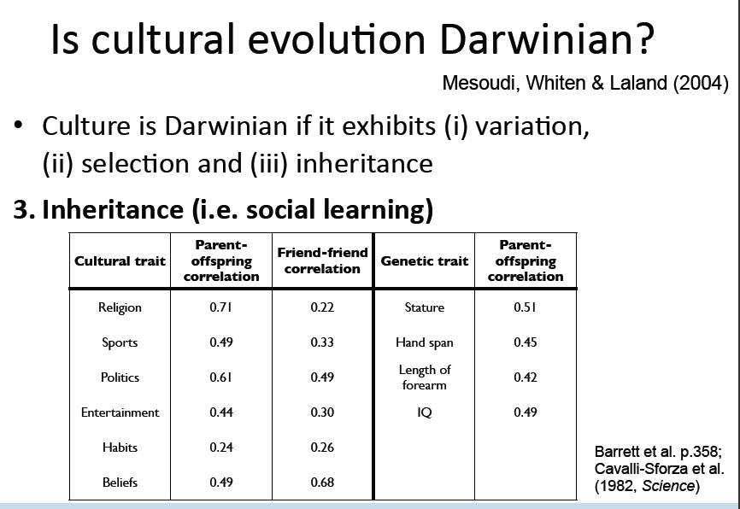

Slide 17
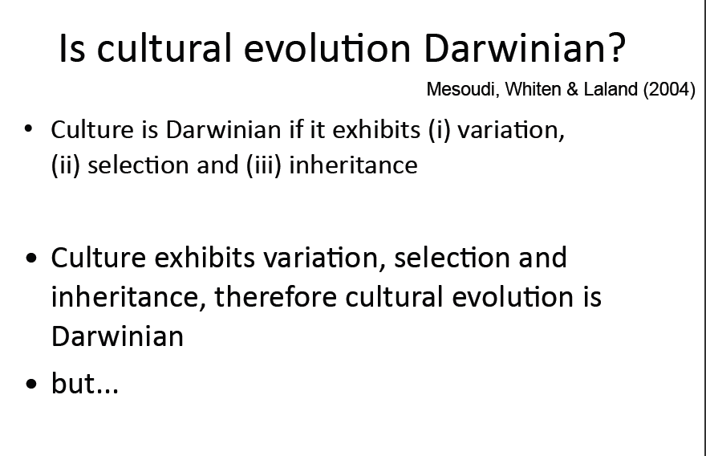

Slide 18
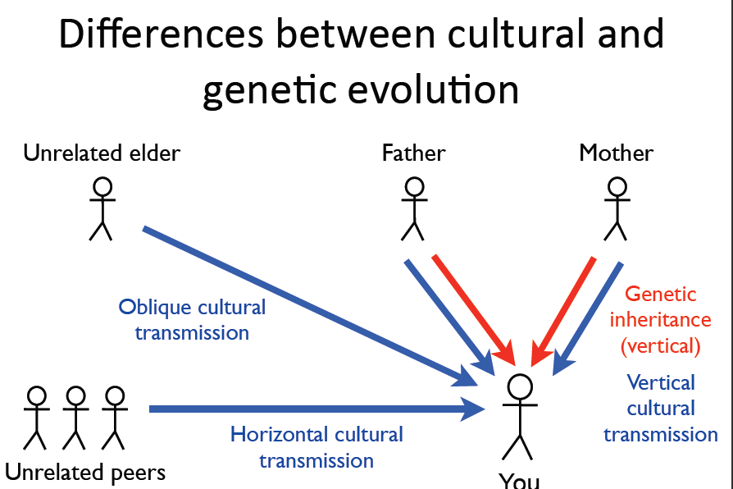

Slide 19
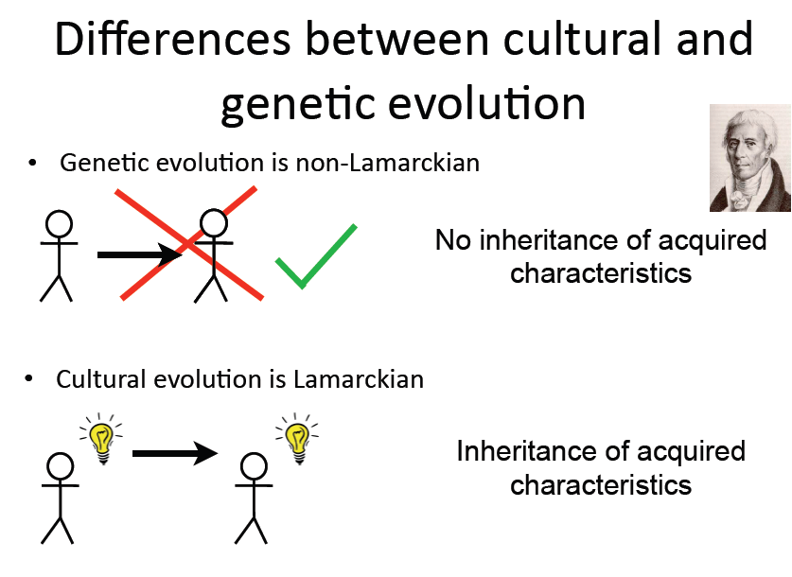

Slide 20
Differences between genetic and cultural evolution:
Genetic evolution is typically high-fidelity (low rate of mutations) and articulate (all or nothing)
Cultural evolution is often low fidelity (high ‘mutation’ rate)

Slide 21
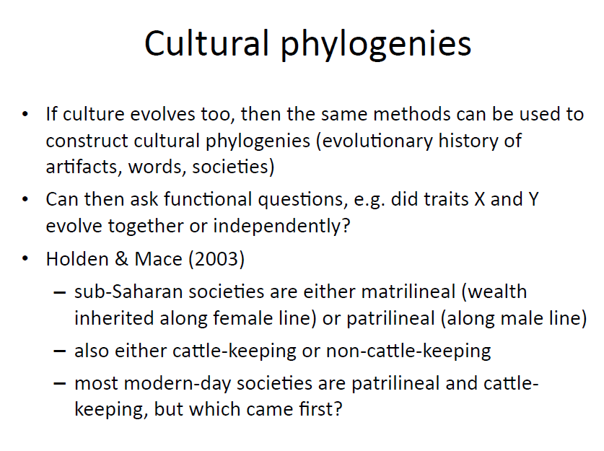

Slide 22
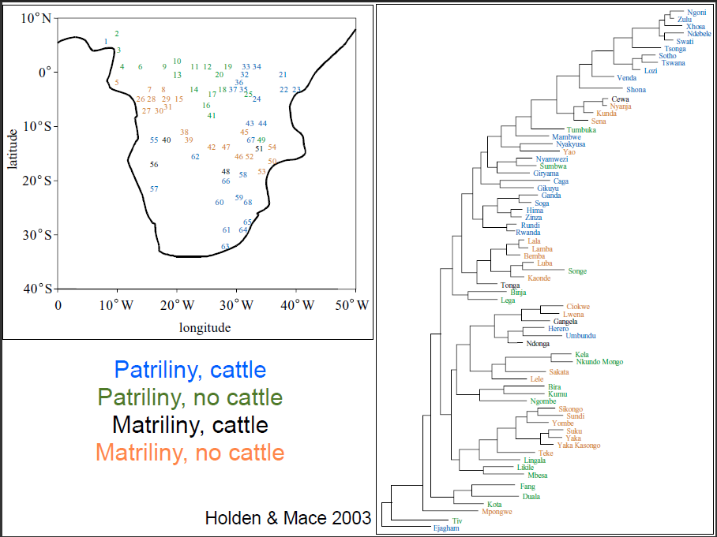

Slide 23
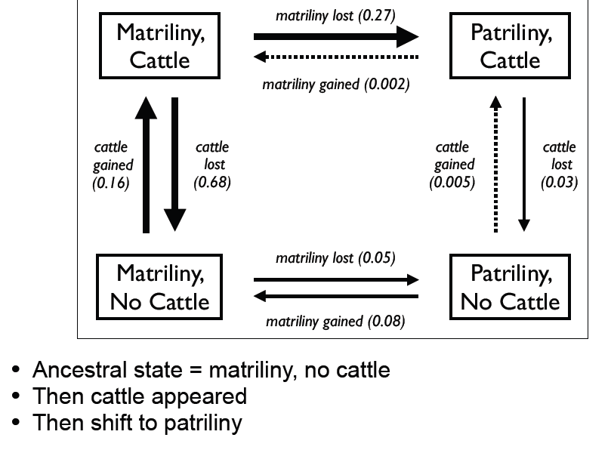

Slide 24
